Slide 1
Lockdown strategies and curve death profiles
A posible correlation between lockdown strategies and death curves for the Novel Coronavirus COVID-19 global outbreak.

Slide 2
Can we infer the lockdown strategy based on the death curve?
Different countries have adopted different strategies:
Minimum lockdown and high testing: Ex: Sweden
Strict lockdown : Ex: Argentina
Strict lockdown with high testing/tracing: Ex South Korea

Slide 3
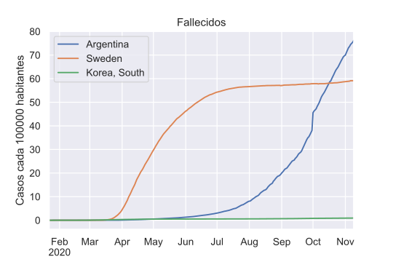
When we plot the death curves for these countries, we can see very different curve profiles. Sweden grows exponentially very fast and stabilizes in a plateau. Argentina doesn´t grow exponentially until June and South Korea increases in a slow and linear pace.

Slide 4
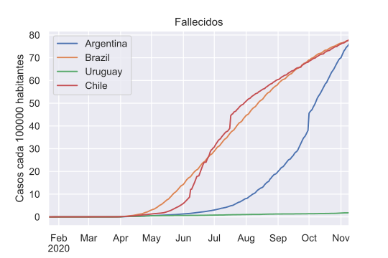
Latin - America

Slide 5
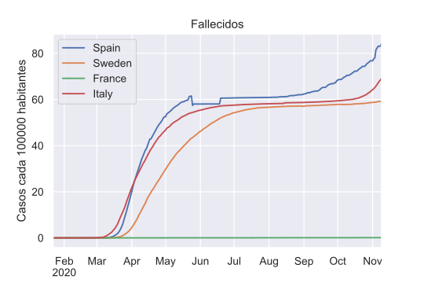
Europe

Slide 6
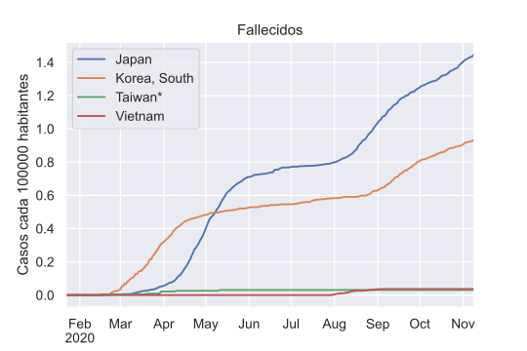
Asia

Slide 7
Continue analysis..
To continue exploring this hypothesis, I would need to consider many other variables that weren´t in this database such as GDP per capita, population density,etc. ‘Our world in data’ database may contain such data.

